Slide 1

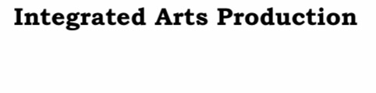
ELEGANT WORK SUMMARY
Reporter name
Click here to add the text, the text is the refinement of your thought, and please try to explain the point of view as succinctly as possible.

Slide 2
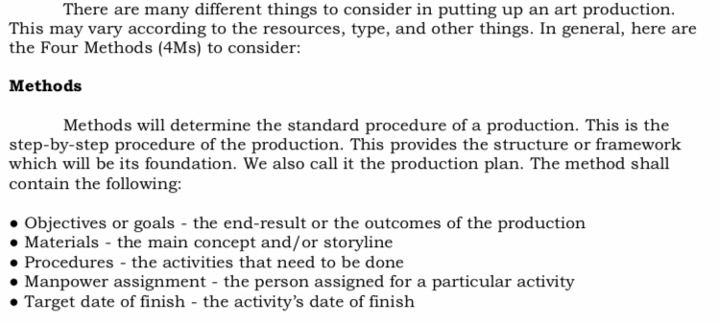
CONTENTS
01
02
Click here to add the text
Click here to add the text
Click here to add the text
Click here to add the text

Slide 3
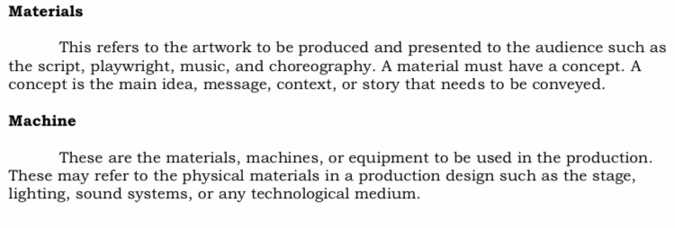
CONTENTS
01
02
03
Click here to add the text
Click here to add the text
Click here to add the text
Click here to add the text
Click here to add the text
Click here to add the text

Slide 4
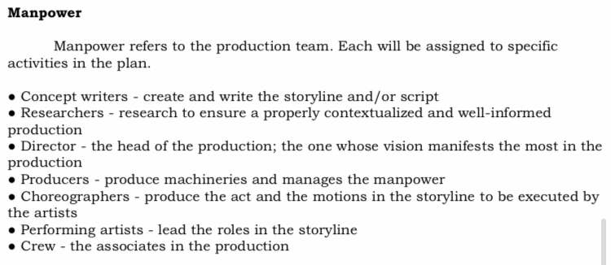
CONTENTS
01
02
03
04
Click here to add the text
Click here to add the text
Click here to add the text
Click here to add the text
Click here to add the text
Click here to add the text
Click here to add the text
Click here to add the text

Slide 5


CONTENTS
01
02
03
04
05
Click here to add the text
Click here to add the text
Click here to add the text
Click here to add the text
Click here to add the text
Click here to add the text
Click here to add the text
Click here to add the text
Click here to add the text
Click here to add the tex

Slide 6
Thank you
Click here to add the text, the text is the refinement of your thought, and please try to explain the point of view as succinctly as possible.

